Slide 1
Unit III
Infrastructure as a Service (IaaS): Introduction to IaaS, Introduction to virtualization, Different approaches to virtualization, Hypervisors, Machine Image, Virtual Machine(VM), Compute options in the cloud, Exploring IaaS with Compute Engine, Configuring elastic apps with auto scaling, Storage options in the cloud, Structured and unstructured storage in the cloud, unstructured storage using Cloud Storage, SQL managed services, Exploring Cloud SQL, Cloud Spanner as a managed service, NoSQL managed service options, Cloud Datastore, a NoSQL document store, Cloud Bigtable as a NoSQL option

Slide 2
Virtualization
Explain what is Virtualization.
Identify why Virtualization.
Identify the scope and necessity Virtualization.
Why do we use it?
Is it really a new technology?.
Identify the different Virtualization Types.
Identify the different Levels of Virtualization.
Identify the Virtualization Technologies.

Slide 3
Virtual Machines
A machine with virtualization software can host numerous applications, including those that run on different operating systems, on a single platform.
The host operating system can support a number of virtual machines, each of which has the characteristics of a particular OS
The solution that enables virtualization is a virtual machine monitor (VMM), or hypervisor.

Slide 4
Virtual Machine Concept

Slide 5
Virtual Machine Consolidation

Slide 6
Approaches to virtualization

Slide 7
Virtualization
Implement on Virtual Machines (VMs):
Abstraction of a physical host machine
Resource (e.g. CPU, memory share),
Software configuration (e.g. O/S, provided services).
Hypervisor intercepts and emulates instructions from VMs, and allows management of VMs,
VMWare, Xen, etc.
App
App
App
OS
OS
OS
Hypervisor
Hardware
Virtualized Stack

Slide 8
Virtual Machines
VM technology allows multiple virtual machines to run on a single physical machine.
App
App
App
App
App
Xen
Guest OS
(Linux)
Guest OS
(NetBSD)
Guest OS
(Windows)
VMWare
VM
VM
VM
Virtual Machine Monitor (VMM) / Hypervisor
UML
Denali
Hardware
etc.

Slide 9
Virtualization in General
Advantages of virtual machines:
Run operating systems where the physical hardware is unavailable,
Easier to create new machines, backup machines, etc.,
Software testing using “clean” installs of operating systems and software,
Emulate more machines than are physically available,
Timeshare lightly loaded systems on one host,
Debug problems (suspend and resume the problem machine),
Easy migration of virtual machines (shutdown needed or not).

Slide 10



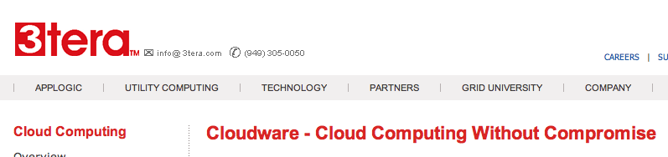






Some Commercial Cloud Offerings

Slide 11
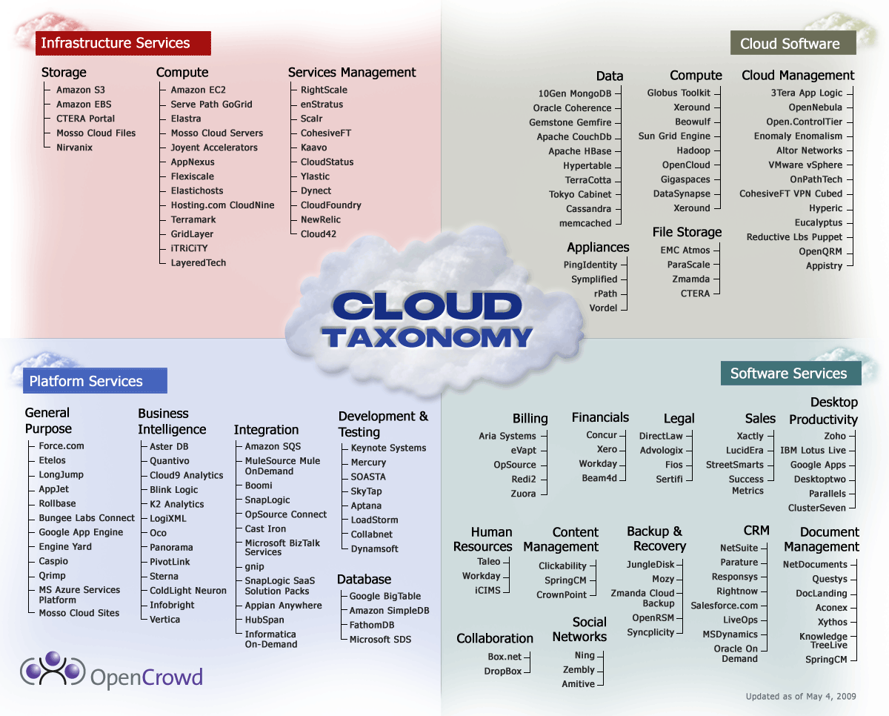
Cloud Taxonomy

Slide 12
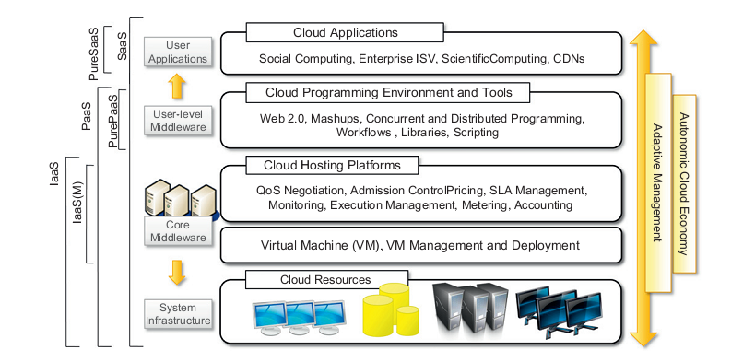
The cloud computing architecture

Slide 13
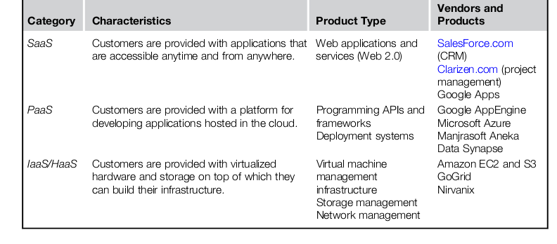
Cloud Computing Services Classification

Slide 14
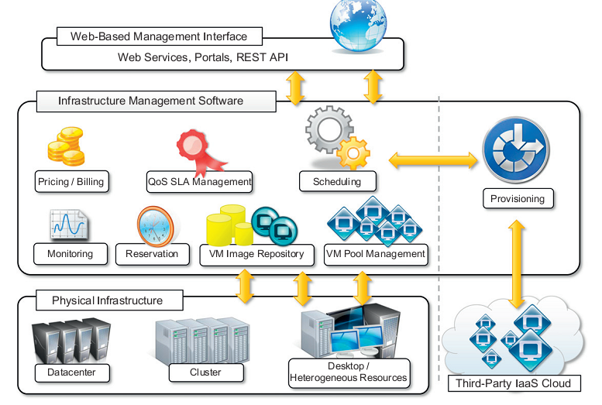
Infrastructure-as-a-Service

Slide 15
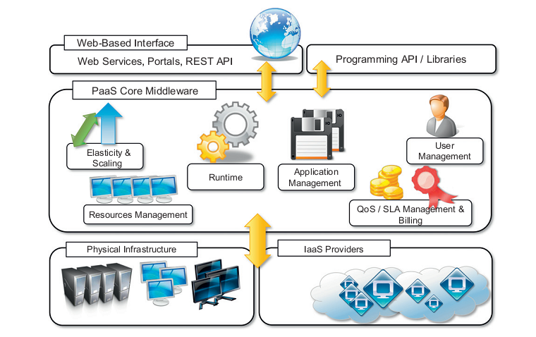
The Platform-as-a-Service reference model

Slide 16
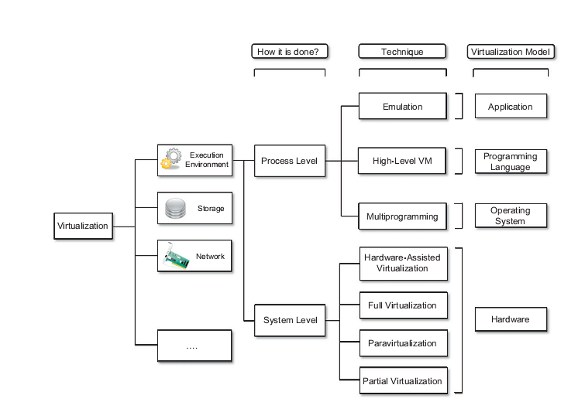
A taxonomy of virtualization techniques.

Slide 17
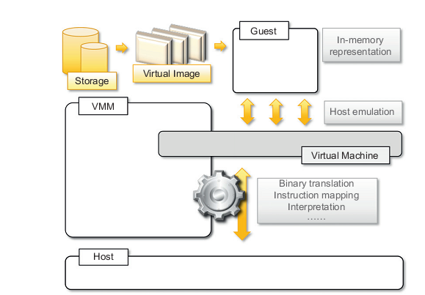
A hardware virtualization reference model

Slide 18
In the computer-age

Slide 19





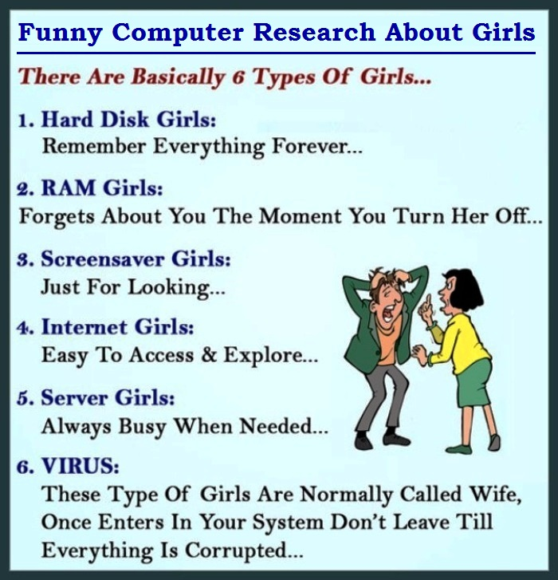

A Lot of Servers/Machines...
Web server
Mail server
Database server
File server
Proxy server
Application server
…and many others

Slide 20
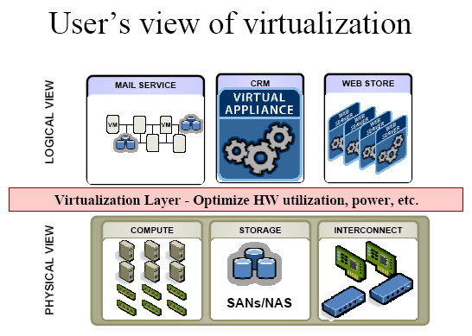
User’s View of Virtualization
SAN: Storage Area Network
NAS: Network Attached Storage

Slide 21
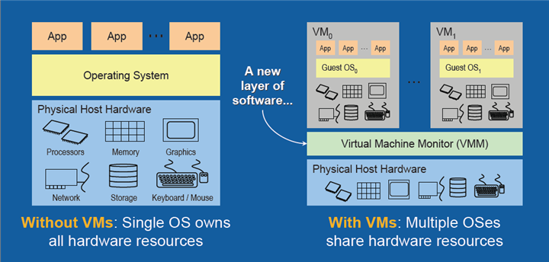
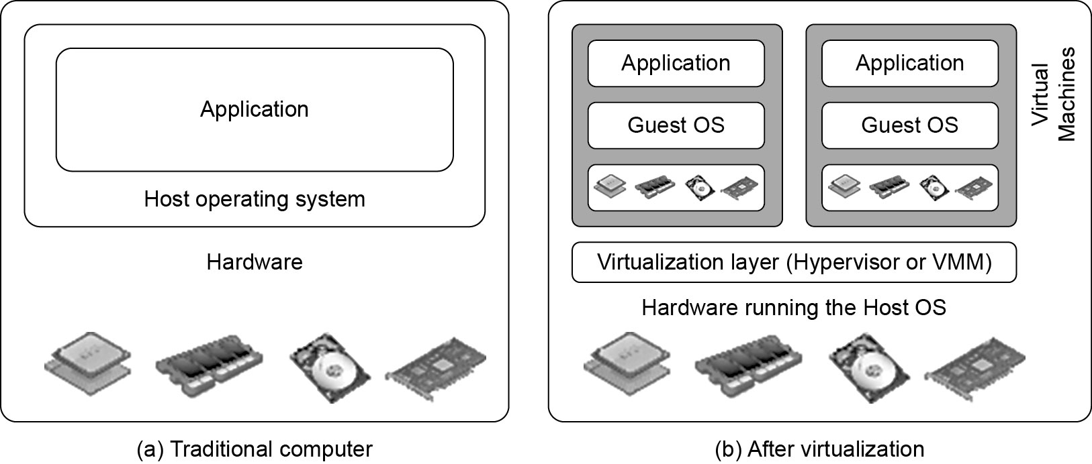
Difference between Traditional Computer and Virtual machines

Slide 22
Virtualization - Basics
The ability to run multiple operating systems on a single physical system and share the underlying hardware resources
Virtualization can be viewed as utility computing, in which computer processing power is seen as a utility that clients can pay for only as needed.
The usual goal of virtualization is to centralize administrative tasks while improving scalability and work loads

Slide 23
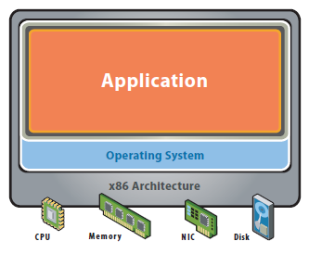
Virtualization example
Dividing your actual hard drive into different partitions.
A partition is the logical division of a hard disk drive to create, in effect, two or more separate hard drives C:, D:, E: etc..
Traditional App/Server

Slide 24
Virtualization - Definition
It is "a technique for hiding the physical characteristics of computing resources from the way in which other systems, applications, or end users interact with those resources.
This includes making a single physical resource (such as a server, an operating system, an application, or storage device) appear to function as multiple logical resources;
OR - it can include making multiple physical resources (such as storage devices or servers) appear as a single logical resource."

Slide 25
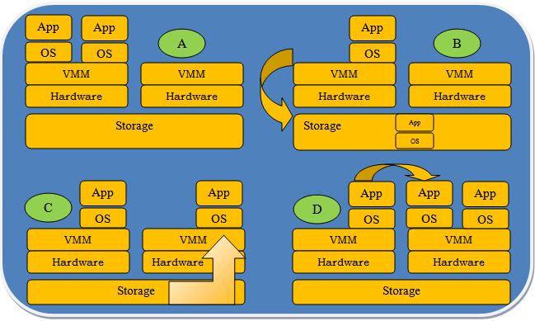
Primitive Operations in Virtual Machines
Multiplexing
Provision(Resume)
S Suspension(Storage)
Life Migration
A
B
C
D

Slide 26
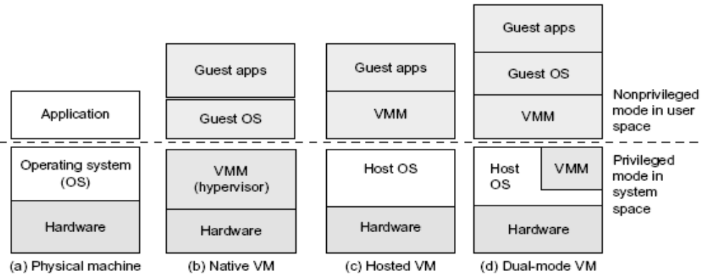
Three VM Architectures
Architecture b, c and d compared with traditional physical machine shown in a

Slide 27
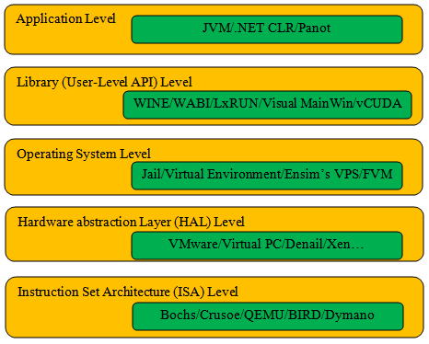

Five Levels of Virtualization ranging from Hardware to Applications

Slide 28

Why Virtualization?
Cost Reduction.
Isolation and creating protected environment.
Testing and evaluation of OS, kernel, or an application.
Ease of duplication.
Relocation (and disaster recovery).
Running Application not supported by the host.
Green IT

Slide 29
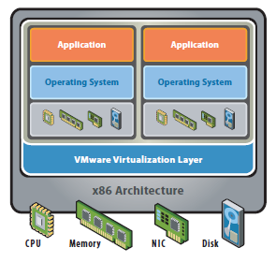
Why Virtualization?
The Reality:
Most servers only use 5-15% of their capabilities on average, while
consuming 60-90% of their peak power
The Solution – Virtualization
Use one server to host multiple applications.
Reduce energy consumption
Reduce CO2 emissions
Running fewer, highly utilized servers frees up space and power. Less space and power is better for environment and saves money.

Slide 30
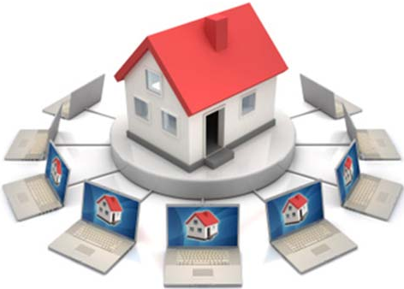
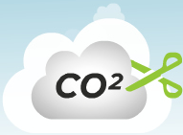



Virtualization Benefits
Reduce Real Estate Needs
Increase Up Time
Reduce CO2 Emissions, Power and Cooling Requirements
Increase Flexibility
Reduce Overall Costs

Slide 31
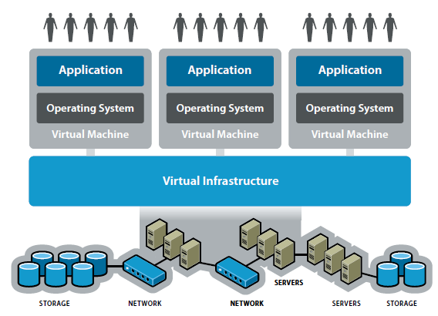
Virtualized Model - Cloud

Slide 32
Implementation Levels of Virtualization
Hardware
Server / OS / Devices ( peripheral devices like printer etc..)
Desktop ( similar to above)
Storage ( Memory, hard disk etc..)
Network
Application software
Data
FULL Virtualization

Slide 33
Virtualization Techniques
Full Virtualization.
OS-level Virtualization.
Partial Virtualization (Historical, not used).
Para-virtualization.
Hardware -assested Virtualization.

Slide 34
Full Virtualization
Full simulation of underlying hardware.
Sharing a computer system among multiple users.
Isolating users from each other (and from the control program).
The result is a system in which all software (including all OS’s) capable of execution on the raw hardware can be run in the virtual machine.
Comprehensively simulate all computing elements as instruction set, main memory, interrupts, exceptions, and device access.
Full virtualization is only possible given the right combination of hardware and software elements.
The host OS emulated a hardware layer for each guest OS.
Notes:
Full virtualization has proven highly successful
Pros: Stability, comptability, guest OS is not patched.
Cons: resources, performance.

Slide 35
Hardware-level virtualization-Server
It is the masking of server resources (including the number and identity of individual physical servers, processors, and operating systems) from server users.
The intention is to spare the user from having to understand and manage complicated details of server resources while increasing resource sharing and utilization and maintaining the capacity to expand later.
How dual boot is different ?
In virtualization multiple OS run simultaneously

Slide 36
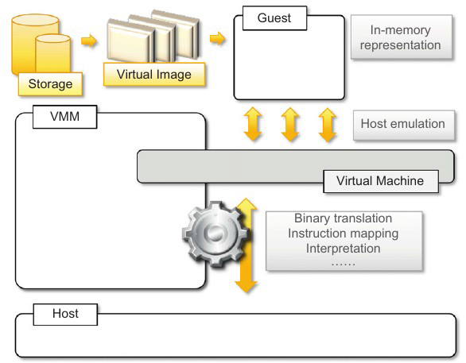
Hardware-level virtualization

Slide 37
OS-Level Virtualization
Concept: Same OS for everyone (host & guest), and isolation is only in the user land.
Pros: low overhead, highest performance.
Cons: isolation, stability.
Examples: FreeBSD Jails, Solaris Containers, Virtuzzo/Open VZ.

Slide 38
Para virtualization
Concept: A thin layer (called the hypervisor), interfaces the hardware to all OS's (host and guest), Dom0 is called ”the privilged domain” which can issue commands to the hypervisor.
If Dom0 crashed (not the hypervisor), the guest OS still runs fine, anyway you won't be able to control the hypervisor till you reboot.

Slide 39
Para virtualization
Pros:
Stability is very close to the hardware virtualization.
Performance is very good (nothing can beat OS-level virtualization in this matter).
Overhead is very low (kernel level only, and not even a complete kernel).
Cons:
Not easy to implement (it's getting better these days).
Both host and guest kernels has to be patched.
Maintainability.
Example: Xen

Slide 40
Hardware- assisted Virtualization
Sometimes it's called accelerated virtualization or HVM (Hardware Virtual Machines).
Concept: Hardware provides support to run instructions independently for each OS.
Implémentation: IBM 370 (1972), Intel VT, AMD-V, UltraSparc, and others.
Exemples: linux KVM, Vmware fusion, M$ VirtualPC, Xen, Virtual Box.

Slide 41
Hardware- assisted Virtualization
Pros:
Highly reduces (theoretically eliminates) the need to patch the guest OS.
Theoretically optimal performance.
Great Stability.
Cons:
Hardware restrictions.

Slide 42
Tools for Virtualization
Amazon EC2 (Elastic Compute Generation 2)
VMware – vSphere (Platform)
Nimbus( Infrastructure as a service)
Open Nebula( Flexible Enterprise Cloud)
Eucalyptus( S/w for building Amazon Web Services)
O-virt (Free, Open source Virtualization Platform, founded by Red Hat as a community project)

Slide 43
Hypervisor
Hypervisor runs above the supervisor mode.
It runs in supervisor mode.
It recreates a h/w environment.
It is a piece of s/w that enables us to run one or more VMs on a physical server(host).
Two major types of hypervisor
Type -I
Type-II

Slide 44
Type-I Hypervisor
It runs directly on top of the hardware.
Takes place of OS.
Directly interact with the ISA exposed by the underlying hardware.
Also known as native virtual machine
Example: IBM CP/CMS hypervisor
Type I Hypervisor
Windows virtual machine
Windows virtual machine
Linux
virtual machine
Linux virtual machine
Para virtualization drivers and tools
Hypervisor (VMware vSphere, Citrix XenServer, Microsoft Hyper-V
**ISA-Internet security and acceleration server
**ABI-Application binary interface
Host – Physical hardware

Slide 45
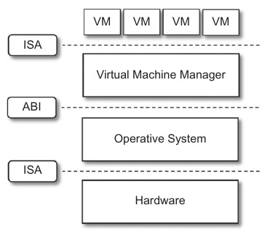
Type-II Hypervisor
It require the support of an operating system to provide virtualization services.
Programs managed by the OS.
Emulate the ISA of virtual h/w.
Also called hosted virtual machine.
Type II Hypervisor
Windows virtual machine
Windows virtual machine
Linux
virtual machine
Linux virtual machine
Para virtualization drivers and tools
Hypervisor (Microsoft Virtual Server, VMware workstation)
Host – Operating system
** ISA-Internet security and acceleration server
**ABI- Application binary interface
Host – Physical hardware

Slide 46
Virtual Machine Manager (VMM)
Main Modules
Dispatcher
Entry Point of VMM
Reroutes the instructions issued by VM instance.
Allocator
Deciding the system resources to be provided to the VM.
Invoked by dispatcher
Interpreter
Consists of interpreter routines
Executed whenever a VM executes a
privileged instruction.
Trap is triggered and the corresponding
routine is executed.

Slide 47
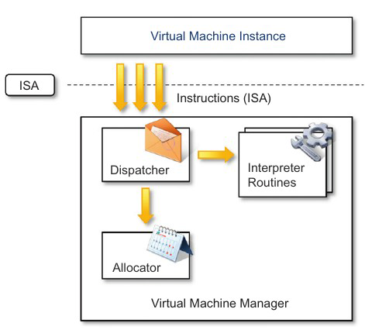
Virtual Machine Manager (VMM)

Slide 48

VMM Architecture
SQL
Management Console
App Controller
Management Server
Hosts (1000 Per Management Server)
Library

Slide 49
Criteria of VMM
Equivalence – same behavior as when it is executed directly on the physical host.
Resource control – it should be in complete control of virtualized resources.
Efficiency – a statistically dominant fraction of the machine instructions should be executed without intervention from the VMM

